Slide 1

Concept Overview Diversity of Sexual Orientation and Diversity of Gender Identity
Summer 2020 Version
Developed by: Professor Marsden

Slide 2
The Population of this Dimension of Diversity
It doesn’t matter where one is around the world, it’s difficult to be certain of the number of people who self-identify as lesbian, gay, bisexual and transgender.
Governments are just beginning to “count” people who are LBGT. Limited census data exists.
Some governments ask if one is married to a same sex partner. (Obviously, not the US government yet, as same-sex marriage was just made legal. The US government asks if one is cohabitating with a same-sex partner.) Those types of relationship-based surveys don’t accurately count the population of people who are LBGT. The transgender and bisexual population is particularly hard to count.
Sources: The Economist, How to Count How Many People Are Gay, May 5, 2015 http://www.economist.com/blogs/economist-explains/2015/05/economist-explains-3
The Williams Institute, LGBT Demographics: Comparisons among population-based surveys, October 2014 http://williamsinstitute.law.ucla.edu/wp-content/uploads/lgbt-demogs-sep-2014.pdf

Slide 3
The 2020 Census does not gather data on people who identify as LBGT
Initially, 2020 Census questions included identification in relation to sexual orientation and gender identity. However, the final Census question material sent to the US Congress was removed.
Source: Sexual Orientation and Gender Identity Erased from 2020 Census and the American Community Survey. National LBGTQ Taskforce https://www.thetaskforce.org/sexual-orientation-and-gender-identity-erased-from-2020-census-and-the-american-community-survey-acs/

Slide 4
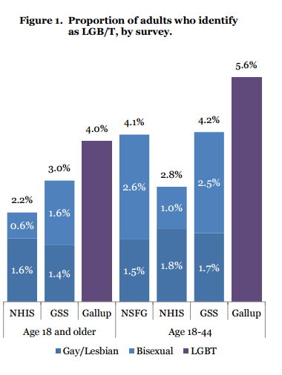
When one sees statistics on people who identify as LBGT, the statistics are often gathered or extrapolated by university- based researchers and independent organizations (like Gallup.)
Figures consistently vary, depending on the source. The sources are also not always measuring the same groups.
Source: The Williams Institute, LGBT Demographics: Comparisons among population-based surveys, October 2014, p. 4 http://williamsinstitute.law.ucla.edu/wp-content/uploads/lgbt-demogs-sep-2014.pdf

Slide 5
What is the US LBGT Population?
It depends on the survey you review
All who identify as LBGT
Gallup Poll (2018) 4.5% of US Population Highest Age Group: 8.1% of Millennials Identified
Harris Poll (2017) 12% of US Population
Highest Age Group: 20% of Millennials Identified
Source: In U.S., Estimate of LGBT Population Rises to 4.5%, Gallup, May 22, 2018.
https://news.gallup.com/poll/234863/estimate-lgbt-population-rises.aspx
Source: New GLAAD study reveals twenty percent of millennials identify as LGBTQ, GLADD, March 30, 2017.
https://www.glaad.org/blog/new-glaad-study-reveals-twenty-percent-millennials-identify-lgbtq

Slide 6
The USCA William’s Institute uses the Gallup poll data that indicates that in 2018, 4.5% of the US population identified as LBGT.
I would trust the Gallup poll data as UCLA does.
I’ve offered the UCLA Interactive website on LBGT data on the week page.
Source: UCLA School of Law, Williams Institute https://williamsinstitute.law.ucla.edu/visualization/lgbt-stats/?topic=LGBT#density

Slide 7
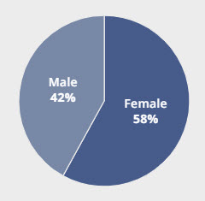
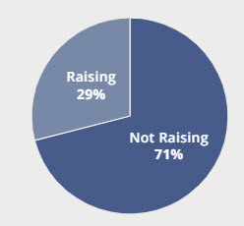
According to the 2018 Gallup Poll
Gender
Raising Children

Slide 8
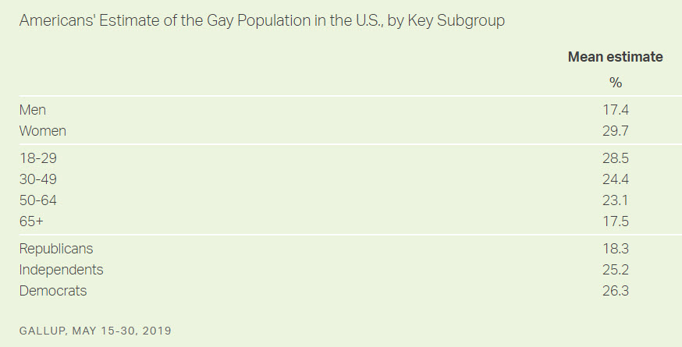
We overestimate the number of people identifying as lesbian, bisexual, gay, transgender and queer in the US.
In 2019, a Gallup poll found that women and those between the ages of 18 and 34 have the highest estimates
Source: Americans Still Greatly Overestimate U.S. Gay Population, Gallup, June 27, 2019
https://news.gallup.com/poll/259571/americans-greatly-overestimate-gay-population.aspx

Slide 9
What Sexual Orientation & Gender Identity Mean
“Sexual Orientation refers to emotional, romantic, sexual, and relational attraction to someone else, whether you’re gay, lesbian, bisexual, or straight. Refrain from using “sexual preference,” “homosexuality,” or “heterosexuality.” In other words, someone can be transgender and straight, or transgender and gay.”
“Gender Identity is one’s internal concept of self as male, female, a blend of both, or neither. It is how individuals perceive themselves, and what they call themselves. One’s gender identity can be the same or different from their sex assigned at birth. For transgender people, their birth-assigned sex and their own sense of gender identity do not match.”
Source: Human Rights Campaign. Reporting About Transgender People? Read This.
Access: https://www.hrc.org/resources/reporting-about-transgender-people-read-this

Slide 10
What’s the “Q” in LBGTQ?
According to the HRC (Human Rights Campaign:
“Queer” serves as an umbrella term that encompasses many people as it intersects with sexual orientation and gender identity. It includes anyone who does not associate with heteronormativity, rather they have non-binary or gender expansive identities.”
Source: Human Rights Campaign. HRC Officially Adopts Use of “LGBTQ” to Reflect Diversity of Own Community, June 3, 2016. https://www.hrc.org/blog/hrc-officially-adopts-use-of-lgbtq-to-reflect-diversity-of-own-community

Slide 11
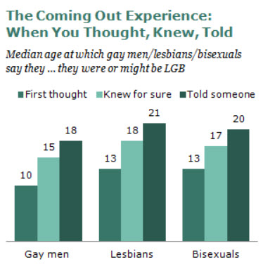
Disclosing (Coming Out)
Source: Pew Research Center. A Survey of LGBT Americans, June 13, 2013
https://www.pewsocialtrends.org/2013/06/13/a-survey-of-lgbt-americans/

Slide 12
LBGT employees are faced with the decision on whether to
disclose their sexual orientation or gender identity.
The HRC (Human Rights Campaign) indicates that there are benefits of being open about one sexual orientation/gender identity.
Eliminates the need to hide or mislead.
Makes deeper friendships possible.
Breaks down barriers to understanding.
Builds trusting working relationships.
Lets us bring our “whole selves” to work.
Being open can make you more productive and can even benefit your career because your peers will see you in a new, perhaps even courageous, light.
Source: Coming Out at Work, Human Rights Campaign http://www.hrc.org/resources/entry/coming-out-at-work

Slide 13
In a 2018 study on the LBGTQ workplace experience, the following was identified.
46% Hide Who They Are At Work
LBGTQ employees are not open at work because:
The possibility of being stereotyped | 38%
The possibility of making people feel uncomfortable | 36%
The possibility of losing connections or relationships with coworkers | 31%
People might think I’m attracted to them just because I’m LBGTQ | 27%
Source: A Workplace Divided: Understanding the Climate for LBGTQ Workers Nationwide. (2018). Human Rights Campaign, 10 – 11. https://assets2.hrc.org/files/assets/resources/AWorkplaceDivided-2018.pdf?_ga=2.140773682.1409974327.1592347854-1874565387.1592347854

Slide 14
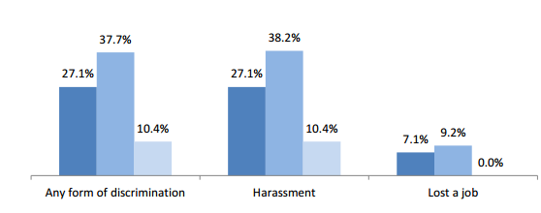

Risks
Research reports vary on the exact percentage that indicate LBGT employees have been discriminated against once they disclose their sexual orientation/gender identity. However, all research agrees that more lesbian and gay employees experience employment discrimination if they have disclosed than if they do not disclose. Example below.
Source of Chart: Documented Evidence of Employment Discrimination & Its Effects on LGBT People, The Williams Institute , UCLA, 2011. http://williamsinstitute.law.ucla.edu/wp-content/uploads/Sears-Mallory-Discrimination-July-20111.pdf

Slide 15
Perception: Social Exclusion vs Career Penalty?
In a 2018 study, subjects obviously perceived more of a social risk than a “career penalty” risk.
Perception of Career Risk vs Social Exclusion
Careers will be negatively impacted if I disclose | 19%
My colleagues will feel uncomfortable around me if I disclose | 70%
However, we should consider that if perceptions were correct and coworkers did feel uncomfortable, could that uncomfortable feeling lead to out-group exclusion?
Source: Trau, R., O’Leary, J., Brown, C. (October 19, 2018). 7 Myths About Coming Out at Work. Harvard Business Review. https://hbr.org/2018/10/7-myths-about-coming-out-at-work

Slide 16
The “B” and the “T” of LBGT
We know about the “L” and the “G” represented in LBGT - Lesbian (female) and gay (male) individuals who are attracted to those of their own gender.
What about those who identify as bisexual and transgender? We don’t hear as much about those two groups of people within the LBGT civil rights movement.

Slide 17
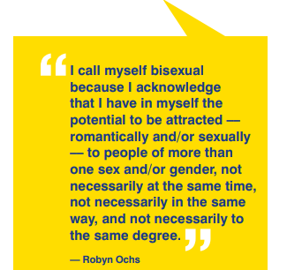
What Bisexual Means
We use Ochs’s definition in this course.

Slide 18
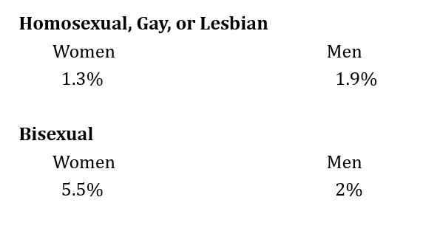
Demographics
Background Information
The bisexual population is the LARGEST GROUP within the LBGT community.
Most recent survey conducted by the US government indicates that there are more female bisexuals (5.5% of population) than lesbians and gay men combined (3.2% of population)
Source: Sexual Behavior, Sexual Attraction, and Sexual Orientation Among Adults Aged 18–44 in the United States: Data From the 2011–2013 National Survey of Family Growth
January 7, 2016. http://i2.cdn.turner.com/cnn/2016/images/01/06/nhsr88.pdf

Slide 19
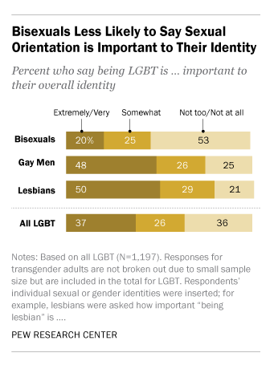
80% of people who are bisexual indicate that their sexual orientation does not greatly impact their identity.
Source: Parker. K. (February 20, 2015.) Among LBGT Americans, bisexuals stand out when it comes to identity, acceptance. Pew Research Center. Accessed: http://www.pewresearch.org/fact-tank/2015/02/20/among-lgbt-americans-bisexuals-stand-out-when-it-comes-to-identity-acceptance/

Slide 20
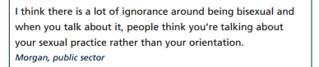
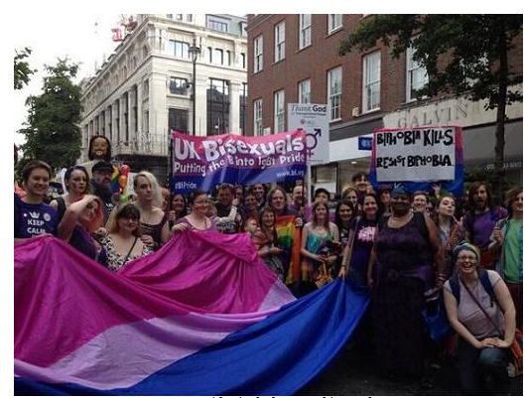
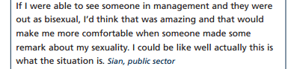
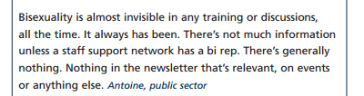
The Bisexual Employee
Bisexuals are actually safe, normal, and boring. Just like you.
The Bisexual Index
Sources: The Bisexual Index http://www.bisexualindex.org.uk/index.php/Bisexuality
Chamberlain, B. (2009). Bisexual People in the Workplace. Stonewall Workplace Guides, p. 9, http://www.stonewall.org.uk/documents/bisexual_people_in_the_workplace.pdf

Slide 21
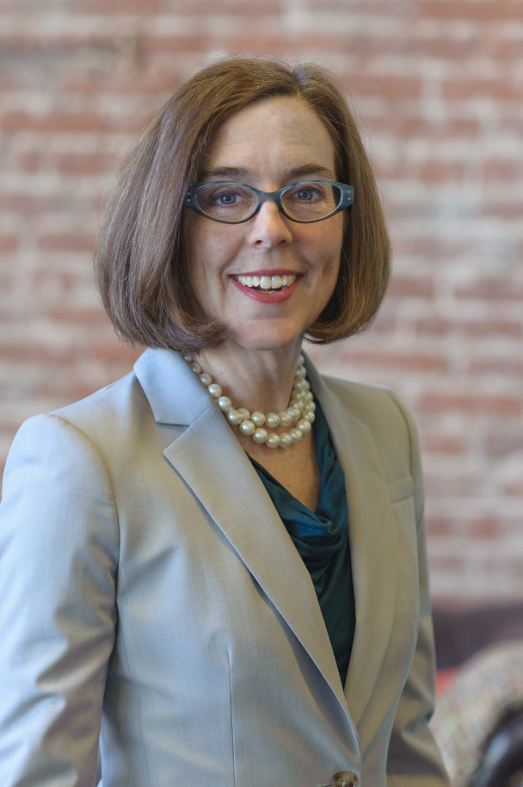
Kate Brown 1st Openly Bisexual US governor
(2015)
“I believe it was during my early 30’s that I figured out who, or what, I am. But it wasn’t until it was written in the Oregonian newspaper that I was bisexual that I had to face the inevitable and let those around me know. Thus began my very public coming out as a bisexual:
Coming out to my parents – who flew in from Minnesota “to have a talk.” Their response – “It would be much easier for us if you were a lesbian.”
Coming out to my gay friends – who called me half-queer.
Coming out to my straight friends – who never thought I could make up my mind about anything anyway.
And, most frighteningly to me:
Coming out to my legislative colleagues …
Some days I feel like I have a foot in both worlds, yet never really belonging to either.”
https://www.oregon.gov/gov/Pages/meet-the-governor.aspx
Governor Brown’s quote above veers from the bisexual norm in that the median age that bisexuals indicate they knew for sure that they were bisexual is 17, not “in one’s 30’s.” Her comments about acceptance mirror the common sentiment shared by bisexuals.
Sources: Out and Elected in the USA: 1974 – 2004, Kate Brown, 1992. Out History.
Accessed: http://outhistory.org/exhibits/show/out-and-elected/1992/kate-brown
Parker. K. (February 20, 2015.) Among LBGT Americans, bisexuals stand out when it comes to identity, acceptance. Pew Research Center. Accessed: http://www.pewresearch.org/fact-tank/2015/02/20/among-lgbt-americans-bisexuals-stand-out-when-it-comes-to-identity-acceptance/

Slide 22
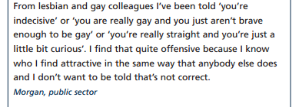
Just as there are myths and stereotypes about lesbian and gay people, myths and stereotypes also exist regarding bisexuals. One common myth is that these individuals “are simply confused” about their sexuality. This is not the case.
Source: Chamberlain, B. (2009). Bisexual People in the Workplace. Stonewall Workplace Guides, p. 4, http://www.stonewall.org.uk/documents/bisexual_people_in_the_workplace.pdf

Slide 23
Inclusion is an issue with bisexuals. One of the challenges of being bisexual is the feeling that they do not “fit” with either homosexuals or heterosexuals. They feel invisible in relation to other identity groups within the LBGT community. The myths associated with bisexuals as well as the feeling of being ostracized impacts this population cohort on both economic and social fronts.

Slide 24
“Bisexuals experience high rates of being ignored, discriminated against, demonized, or rendered invisible by both the heterosexual world and the lesbian and gay communities. Often, the entire sexual orientation is branded as invalid, immoral, or irrelevant. Despite years of activism and the largest population within the LGBT community, the needs of bisexuals still go unaddressed and their very existence is still called into question.”
Source: Bisexual Invisibility: Impacts and Recommendations - San Francisco Human Rights Commission - March 2011, p. 1. http://ww2.lgbtqnation.com/wp-content/uploads/2011/03/bi-invisibility.pdf

Slide 25
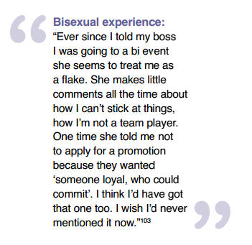
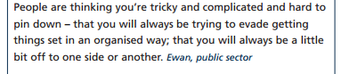
The Impact of Disclosing at Work
Source: Chamberlain, B. (2009). Bisexual People in the Workplace. Stonewall Workplace Guides, p. 6, http://www.stonewall.org.uk/documents/bisexual_people_in_the_workplace.pdf
Source: The Bisexuality Report – The Open University – February 2012 Centre for Citizenship, Identifies and Governance/Faculty of Health and Social Care, p. 24. http://www.open.ac.uk/ccig/files/ccig/The%20BisexualityReport%20Feb.2012.pdf

Slide 26
Bisexual in the Workplace
are discriminated against because others believe they are either homosexual – or - heterosexual.
experience a high level of ignorance that is evidenced by ongoing questioning in the workplace about their sexuality.
are reluctant to disclose their sexual orientation for fear of being judged or losing their jobs.

Slide 27
do not experience the support that is provided to lesbian and gay employees; for example affinity networks.
are not discussed in staff diversity training.
talk about their sexual orientation in the workplace less than lesbians and gay people.
Sources:
Human Rights Campaign. (2018). Bisexual Visibility in the Workplace. https://assets2.hrc.org/files/images/resources/Bi_Inclusion_One_Sheet_FINAL_2018.pdf?_ga=2.119725320.1219379327.1540849041-417485493.1539295660
Chamberlain, B. (2009). Bisexual People in the Workplace. Stonewall Workplace Guides,, http://www.stonewall.org.uk/documents/bisexual_people_in_the_workplace.pdf
The Bisexuality Report – The Open University – February 2012 Centre for Citizenship, Identifies and Governance/Faculty of Health and Social Care
http://www.open.ac.uk/ccig/files/ccig/The%20BisexualityReport%20Feb.2012.pdf
Bisexual Invisibility: Impacts and Recommendations - San Francisco Human Rights Commission - March 2011
http://ww2.lgbtqnation.com/wp-content/uploads/2011/03/bi-invisibility.pdf
Common Myths of Bisexuality, http://www.uic.edu/depts/quic/bisandallies/myths.html

Slide 28
The Transgender Employee
Background Information
Transgender individuals are those whose personal identity is different than the gender of the individual’s birth.
While bisexuals outnumber lesbians and gay males within the LBGT cohort, transgendered people comprise the smallest group within the LBGT cohort.
According to the latest Williams Institute survey, approximately 0.6% of Americans identify as transgender. That percentage equates to 1.4 million people. The US government doesn’t ask about one’s gender identity on any government form.
Source: The Williams Institute. (June 30, 2016.) Updated Estimates Show 1.4 Million Adults Identify as Transgender in the US, Doubling Estimates from A Decade Ago. Accessed: http://williamsinstitute.law.ucla.edu/press/press-releases/updated-estimates-show-1-4-million-adults-identify-as-transgender-in-the-us-doubling-estimates-from-a-decade-ago/

Slide 29
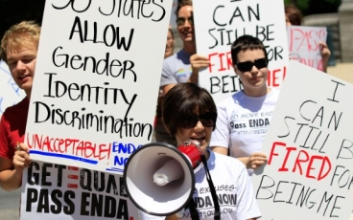
There are a variety of challenges to the transgender people involving discrimination and exclusion emanating from families, communities and the workplace
http://www.transequality.org/issues/employment
From the chart provided on the next side, one can recognize the type of workplace challenges transgender employees experience. These challenges come at a cost to the individual. By analyzing data from the National Transgender Discrimination Survey, startling conclusions can be drawn.
For example, 65% of study subjects who experience violence at work and 59% of those were denied access to appropriate bathrooms attempted suicide.
Source: Suicide Attempts Among Transgender and Gender Non-Conforming Adults – The Williams Institute – January 2014
http://williamsinstitute.law.ucla.edu/research/suicide-attempts-among-transgender-and-gender-non-conforming-adults/#sthash.O7b3m5pv.dpuf

Slide 30
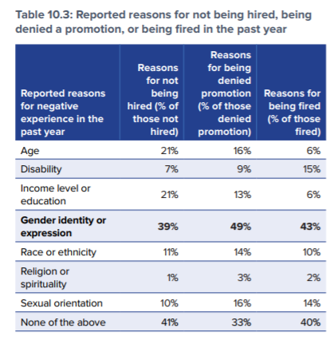
Source: 2015 US Transgender Survey p. 191; National Center for Transgender Equity
http://www.transequality.org/sites/default/files/docs/usts/USTS%20Full%20Report%20-%20FINAL%201.6.17.pdf

Slide 31
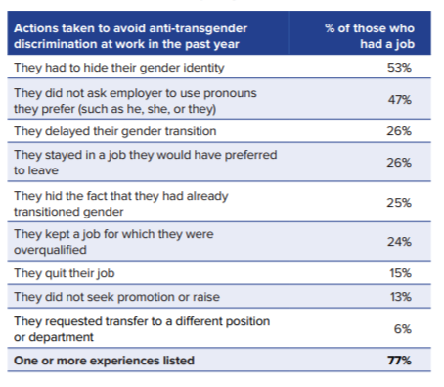
Source: 2015 US Transgender Survey p. 191; National Center for Transgender Equity
http://www.transequality.org/sites/default/files/docs/usts/USTS%20Full%20Report%20-%20FINAL%201.6.17.pdf

Slide 32
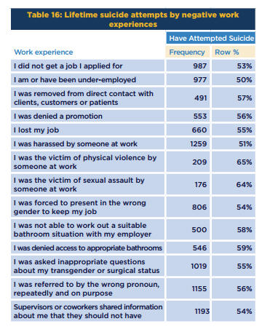
Source: Suicide Attempts Among Transgender and Gender Non-Conforming Adults – The Williams Institute – January 2014
http://williamsinstitute.law.ucla.edu/research/suicide-attempts-among-transgender-and-gender-non-conforming-adults/#sthash.O7b3m5pv.dpuf

Slide 33
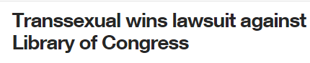
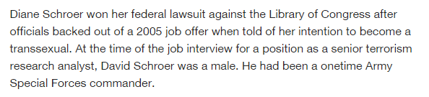
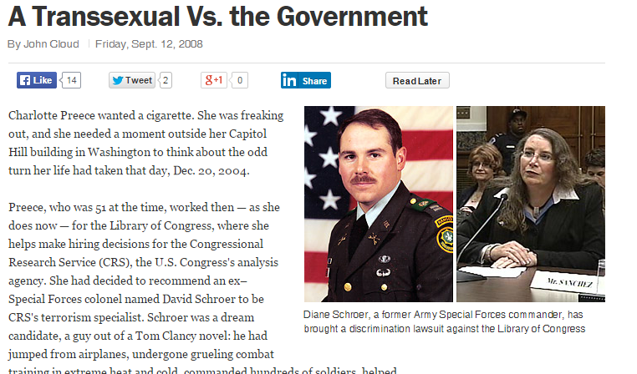
This week you’ll listen to Ms. Schroer regarding her experience of being discriminated against by the US Government (Library of Congress.)
Recognize that if the Executive Order 11246 discussed later in this slide set was in effect at the time she applied for the position, her potential employer couldn’t have denied her the position.

Slide 34
Ninety percent (90%) of transgender employees report harassment, mistreatment or discrimination on the job or took actions like hiding who they are to avoid it. (Injustice at Every Turn)
More than 25% of transgender employees have lost a job because of the bias associated with transgender employees. (National Center for Transgender Equality)
Sources:
Injustice at Every Turn, A Report of the National Transgender Discrimination Survey (executive Summary), The National Gay and Lesbian Task Force and the National Center for Transgender Equality, 2014, p. 2
https://fortunedotcom.files.wordpress.com/2014/09/executive_summary.pdf
National Center for Trans gender Equity. Employment Issues. Accessed: http://www.transequality.org/issues/employment

Slide 35
Transgender in the Military
“Don’t Ask, Don’t Tell” (DADT) was repealed by Congress and the repeal legislation was signed into law by President Obama in 2010. The repeal allowed gay and lesbian and bi-sexual military personnel to serve openly in the military.
Transgender military personnel had to remain “closet(ed)” – the repeal of DADT did not cover transgender people in the military. Trans people were banned by health regulations that were instituted in the 1970’s – where trans people are described as having “psychosexual conditions.”
In a 2014 government report, the US Surgeon General recommended an end to the ban on transgender people serving in the military, noting the outdated medical reasoning for exclusion. The US Defense Secretary indicated that he is “open to lifting the ban,” In 2016 the ban was lifted.
Sources:
US officials: Military worries about easing transgender ban, Associated Press, March 2015
http://news.yahoo.com/ap-sources-concerns-over-easing-transgender-ban-military-071719922.html
Transgender military members are in a precarious position, Washington Post, 2014
http://www.washingtonpost.com/politics/transgender-military-members-are-in-a-precarious-position/2014/10/27/38204fd6-5870-11e4-b812-38518ae74c67_story.html

Slide 36
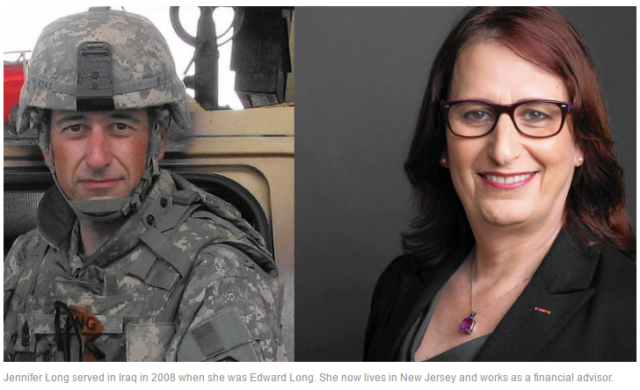
About 21% of all transgender adults have served in the US military.
People who are transgender serve in the military at a disproportionate rate compared to the general US population.
Source: Zarembo, A. (September 4, 2015.) Why Do Transgender People Join the Military in Such High Numbers? Los Angeles Times. Accessed: http://www.latimes.com/nation/la-na-transgender-military-20150904-story.html

Slide 37
While it may come to a surprise to some students, there are enough trans ex-military veterans to warrant a Transgender American Veteran’s Association.
Two VA clinics provide services specifically for transgender veterans.
Transgender people serve the citizens of the US in the military at a higher rate (15%) than the general population of the US serves in the military.
Sources: Jenkins. J. (December 29, 2015.) New VA Clinic Opens for Transgender Vets. (print and audio.) Accessed:
http://www.npr.org/2015/12/29/460955296/new-va-clinic-opens-for-transgender-vets
Transgender American Veteran’s Association. Accessed: http://transveteran.org/
2015 US Transgender Survey p. 166 - 168; National Center for Transgender Equity
http://www.transequality.org/sites/default/files/docs/usts/USTS%20Full%20Report%20-%20FINAL%201.6.17.pdf

Slide 38
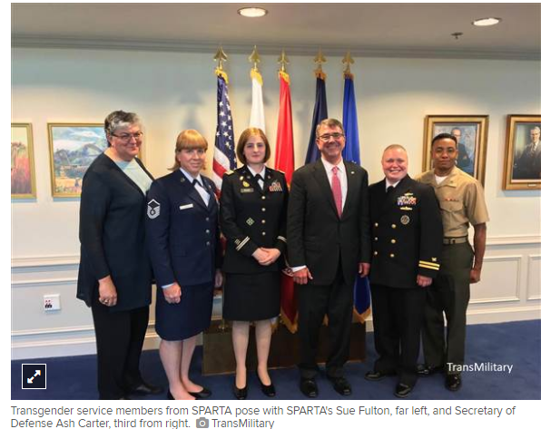
“Outdated medical and administrative policies have banned transgender people from serving in the U.S. military, yet 18 other countries allow their service.”
These countries include the United Kingdom and Israel.
(NBC News)
On June 30, 2016, US Secretary of Defense indicated that the ban of transgender service people is being lifted. Transgender people will be allowed to openly serve in the US military. Medical benefits specific to the needs of transgender people are to be made available.
http://www.nbcnews.com/feature/nbc-out/trans-service-members-detail-historic-meeting-defense-secretary-n601676
Sources: Dawson, F. (June 30, 2016.) Trans Service Members Detail Historic Meeting With Defense Secretary. NBC News. Accessed: http://www.nbcnews.com/feature/nbc-out/trans-service-members-detail-historic-meeting-defense-secretary-n601676
Kube. C. (June 30, 2016.) Pentagon Lifts Ban on Transgender Service Members Serving Openly. NBC News. Accessed:
http://www.nbcnews.com/feature/nbc-out/pentagon-lifts-ban-transgender-service-members-serving-openly-n601816

Slide 39
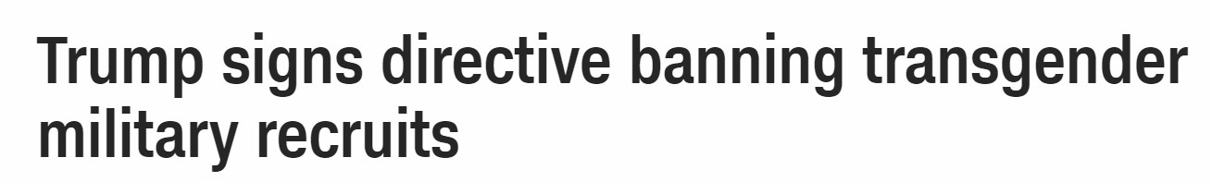
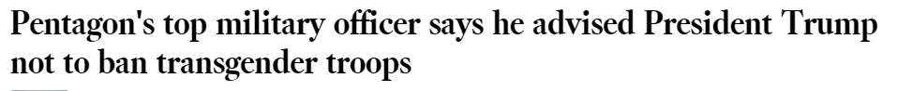
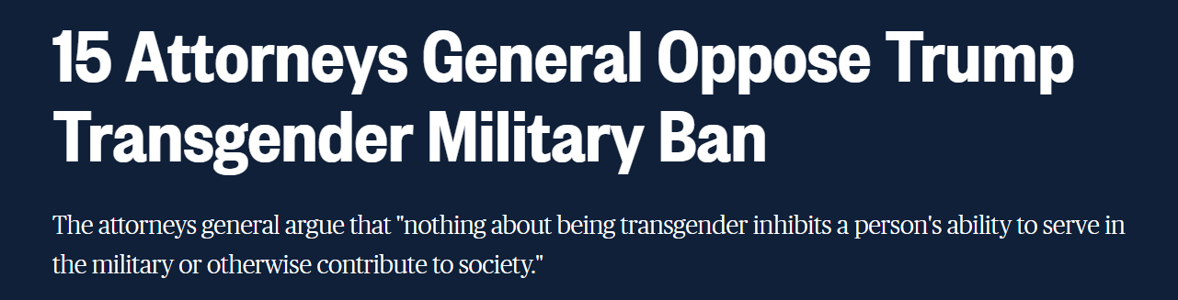
President Trump has attempted to reinstitute a military service ban on transgender people
August, 2017
http://www.cnn.com/2017/08/25/politics/trump-transgender-military/index.html
October 2017 https://www.nbcnews.com/feature/nbc-out/15-attorneys-general-oppose-trump-transgender-military-ban-n811416

Slide 40

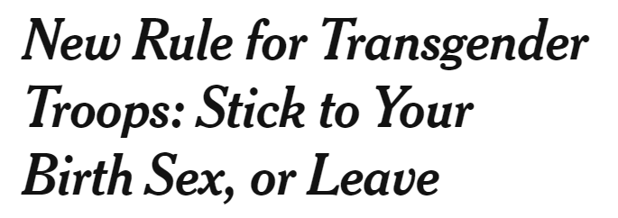
On April 12, 2019, the US Defense Department put into affect a new policy where “troops and recruits can identify as transgender, but must use the uniforms, pronouns, and sleeping and bathroom facilities for their biological sex. They will not be allowed to serve if they have a diagnosis of gender dysphoria, a disorder in which a person’s gender identity does not match their physical gender at birth.” Service people who already disclosed as transgender and have transitioned or have begun the medical process of transitioning are exempt.
Source: New Rule for Transgender Troops: Stick to Your Birth Sex, or Leave, New York Times, March 13, 2019. https://www.nytimes.com/2019/03/13/us/transgender-troops-ban.html

Slide 41
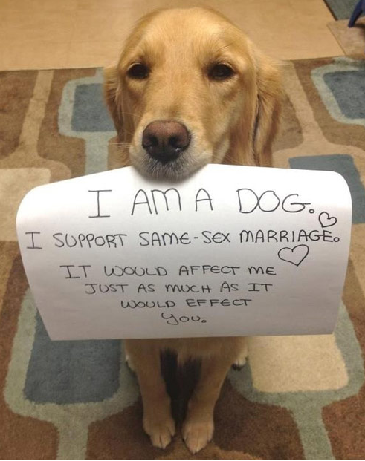
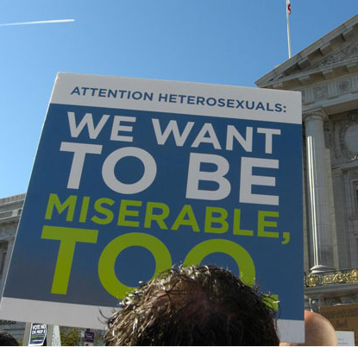
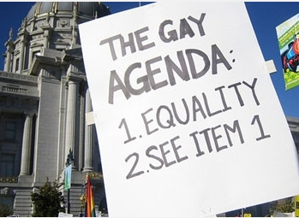
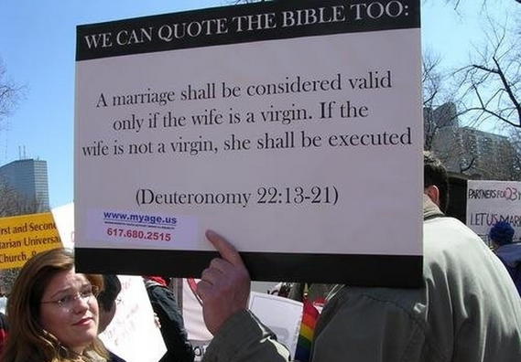
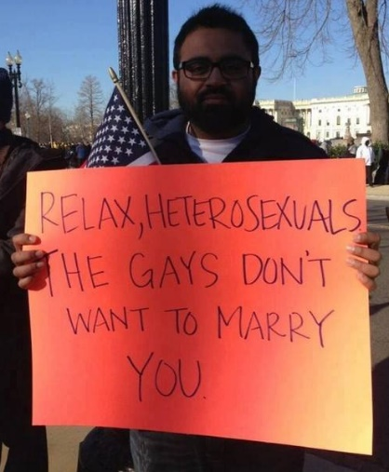
Why Marriage Equality is an Employment Issue (and not only a religious and political issue)
Source: The Funniest Protest Signs Ever. About.com http://politicalhumor.about.com/library/bl-funniest-protest-signs.htm?x=51&y=289&PS=297%3A34

Slide 42
Latest survey indicates that 61% of the US population supports same-sex marriage.
For Millennials, the support increases to 74%
Source: Attitudes on Same-Sex Marriage, Pew Research Center, May 14, 2019. https://www.pewforum.org/fact-sheet/changing-attitudes-on-gay-marriage/

Slide 43
Why should we be interested in marriage equality in this course?
Below is what marriage can offer the spouse of an employee. Lesbian and gay employees want to be offering the same to their loved one:
Access to healthcare (ability to put one’s wife or husband on their health care plan)
Pension benefits (ability for spouse to receive pension benefits upon death of the loved one)
Ability to use family medical leave to take care of spouse.

Slide 44
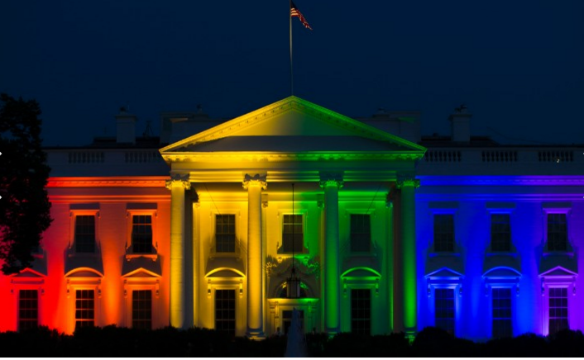
In June of 2015, the US Supreme Court ruled that same-sex marriage is legal throughout the country. That meant that in the 14 states that banned same-sex marriage at the time of the ruling, the state would no longer be able to enforce the ban.
June 26, 2015: The White House is lit in rainbow colors to commemorate SCOUS ruling to legalize same-sex marriage nationwide.
With marriage legal in the US, lesbian and gay employees should have access to the same workplace benefits that other heterosexual married couples do
(For example, access to benefits and pensions.)

Slide 45
Laws Protecting LBGT from Employment Discrimination
Understanding the Patchwork of Protection
for (Some) LBGT Employees
Federal Level ENDA - Senate Bill
The Equality Act – House Bill - EEOC (Use of Title VII for Sexual Orientation and Transgender Employment Discrimination Protection) - Executive Order
State

Slide 46
On the Federal Level
On the federal level, no law exists that specifically offers protection against employment discrimination and harassment for LBGT employees. Sexual orientation and gender identity is not specifically protected under Title VII of the Civil Rights Act of 1964.

Slide 47
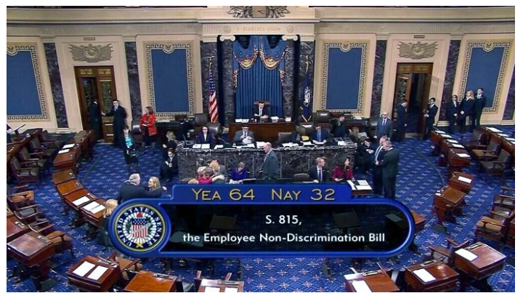
In November 2013 the US Senate passed the Employment Non-Discrimination Act (ENDA.)
The ENDA was first filed by Senator Edward Kennedy in 1994.
It took 19 years for the bill to be passed in the Senate.

Slide 48
At the time, the bill had to be voted on by the House of Representatives.
If the ENDA would have pass in the House, President Obama indicated that he would have signed the bill into law. Members of the republican dominated House opposed ENDA.
After over 4 years – the bill never got out of committee in the House.
The bill was dead.

Slide 49
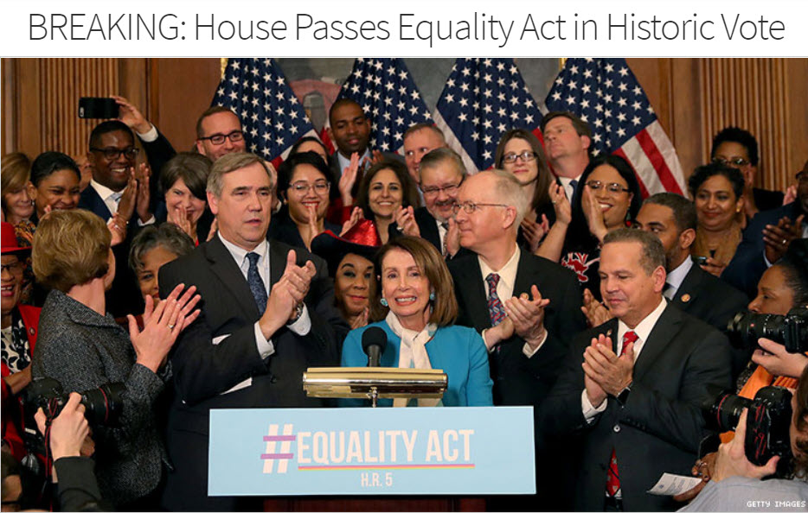
The Equality Act
Since the time of the passing of the ENDA in the Senate, the climate in the House of Representatives has changed.
The change occurred after elections brought more LBGTQ friendly legislators into the House.
In May of 2019, the House passed H. R. – 5 – The Equality Act.

Slide 50
The Equality Act, which was first introduced into the House of Representatives in 2015, offers, among other protections, employment discrimination protections on the basis of sexual orientation and gender identity by adding “sexual orientation” and “gender identity” to the 1964 Civil Rights Act.
According to a recent national survey, a majority of Americans – from every demographic group – support non-discrimination protection laws for people who identify as LBGT.
Sources:
House Passes Sweeping LGBTQ Nondiscrimination Bill in Historic Vote, May 17, 2019, NBC News. https://www.nbcnews.com/feature/nbc-out/house-passes-sweeping-lgbtq-nondiscrimination-bill-historic-vote-n1007001
Americans Show Broad Support for LGBT Nondiscrimination Protections, PRRI, March 12, 2019. https://www.prri.org/research/americans-support-protections-lgbt-people/

Slide 51
The Senate Majority Leader has indicated that he will not bring the bill to the Senate for a vote.
President Trump does not support the bill.
The Equality Act could experience the same fate as the ENDA did after it was passed years ago.
Source: Trump Opposes Federal LGBTQ Nondiscrimination Bill, Citing ‘Poison Pills’ NBC News, May 14, 2019. https://www.nbcnews.com/feature/nbc-out/trump-opposes-federal-lgbtq-nondiscrimination-bill-citing-poison-pills-n1005551

Slide 52
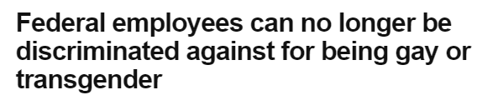
Executive Orders
For Federal Employees
Original Executive Order - 11478
President Clinton: Executive Order Amended:
Executive Order barring discrimination against federal employees (on basis of race, color, religion, sex, national origin, disability and age) Added sexual orientation to the list of protected categories in federal employment.
President Obama:
Executive Order Amended:
President Clinton’s amendment.
Added gender identity to the list of protected categories in federal employment.

Slide 53
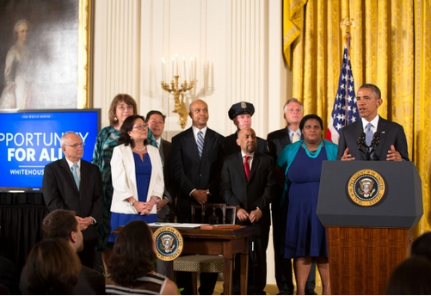
For Employees of Federal Contractors/Subcontractors – Original Executive Order - 11246
President Obama: Executive Order Amended:
President Johnson’s Executive Order barring federal contractors from discriminating (on basis of race, color, religion, sex, national origin)
Added sexual orientation AND gender identity to the policy.

Slide 54
For Employees of Federal Contractors/Subcontractors - 11246
There is no religious exemption for faith-based businesses.
There is a small exemption for religious organizations.
Religiously affiliated contractors can still favor individuals of a particular religion when making employment decisions. (For example, a Catholic hospital that accepts federal dollars can still prefer to hire/promote Catholic nurses – because the nurses are Catholic.)
However, religious organizations that accepts federal dollars (like the Catholic hospital) cannot take the sexual orientation or gender identity of an applicant or employee into account when making employment decisions.
President Trump’s Department of Labor is currently attempting to impact this Executive Order.

Slide 55
President Obama’s Executive Order that addresses both federal employees and employees of federal contractors was signed in 2014. The Executive Order went into effect in April 2015.
The Obama White House estimated that 1.5 million workers will be protected.
“This will effectively prevent any company that does business with the government from firing an employee based on who they are or who they love.”

Slide 56
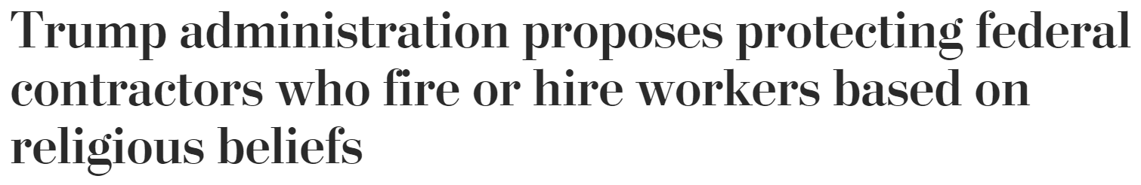

August 2019
Under President Trump’s administration the US Department of Labor has published a proposal to protect religiously based non-profits and businesses from acting against their beliefs in employment actions. Religious organizations (like Catholic Charities) are already exempt from Obama’s Executive Order that offered employment protection to LBGTQ employees who work for federal contractor.
“The new rule “is the latest in a line of steps by the Trump administration to clarify protections for religious believers that critics have often seen as coming at the expense of LGBTQ rights.”
Source:
Trump Administration Proposes Protecting Federal Contractors Who Fire or Hire Workers Based on Religious Beliefs. Washington Post, August 14, 2019. https://www.washingtonpost.com/religion/2019/08/14/trump-administration-proposes-protecting-federal-contractors-who-fire-or-hire-workers-based-religious-beliefs/

Slide 57
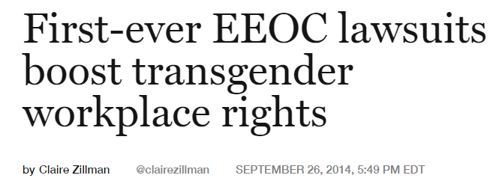
The EEOC
The EEOC considers employment discrimination for transgender employees under Title VII where employers are forbidden to discriminate because of an employee’s sex.

Slide 58
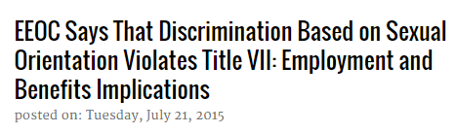
The EEOC
In 2015, the EEOC announced that they changed perspective and policy regarding leveraging existing Title VII employment protections of lesbian and gay people who have been discriminated against because of their sexual orientation.
The EEOC, uses protection from discrimination because of sex (a Title VII protection) in cases that involve employment discrimination of lesbian and gay employees.

Slide 59
The EEOC
Commission comment:
“We conclude that sexual orientation is inherently a ‘sex-based consideration,’ and an allegation of discrimination based on sexual orientation is necessarily an allegation of sex discrimination under Title VII. “
The commission’s perspective on the ability to ligate sexual orientation and employment cases supports those who reside in the states where employment discrimination because of sexual orientation is still legal.
Source: National Law Review, EEOC Says the Discrimination Based on Sexual Orientation Violates Title VII: Employment and Benefits Implications, July 21, 2015 http://www.natlawreview.com/article/eeoc-says-discrimination-based-sexual-orientation-violates-title-vii-employment-and-

Slide 60
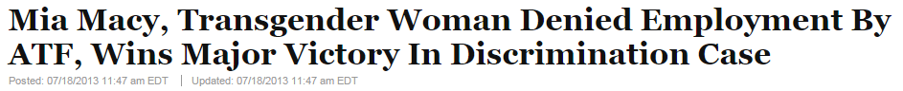
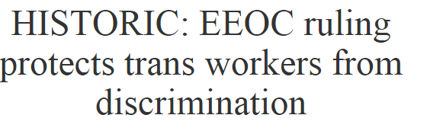

This week, you’ll hear from Mia Macy, a military veteran and a past detective on the Phoenix police force, regarding the employment discrimination she faced because she transitioned from a male to a female.
Ms. Macy’s claim was the first transgender case that EEOC supported after its historic decision that transgender people could be protected by Title VII of the Civil Rights Act.

Slide 61
The next two slides highlight two cases that were brought to the US Appetit Courts that involved the EEOC’s perspective that employment discrimination because of one’s sexual orientation is sex discrimination with differing results.

Slide 62

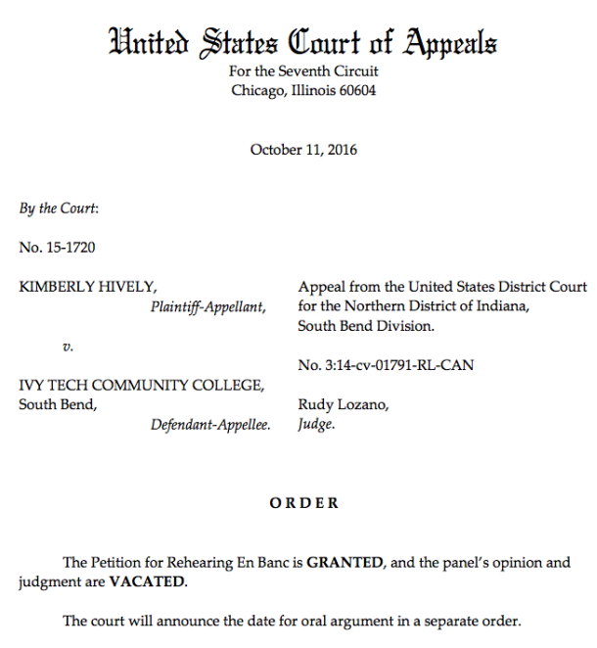
Hively vs Ivy Community College
Professor Kimberly Hively, claiming employment discrimination based on her sexual orientation as a lesbian took Ivey Community College to court and lost because judges didn’t agree that Title VII provided protection based on sexual orientation, as the EEOC contends.
Professor Hively’s attorneys petitioned the 7th District Court of Appeals to review the case. The case was accepted. The case was won in April 2017. The US Court of Appeals ruled in favor of Hively and supported the EEOC’s interpretation of Title VII. Professor Hively can now sue the community college for employment discrimination.
Lesbian plaintiff in work discrimination suit sticking to fight
https://edition.cnn.com/2017/04/05/us/lgbt-employees-appeals-court-plaintiff/index.html

Slide 63

2017 – Evens v. Georgia Regional Hospital
Jameka Evans lost her case.
11th District Court of Appeals did not agree with the EEOC - that employment discrimination based on sexual orientation is covered under sex discrimination.
The U.S. Supreme Court declined to review the 11th District Court of Appeals ruling on the Evans case.
Source: Reuters - https://www.reuters.com/article/us-usa-court-lgbt/u-s-high-court-turns-away-dispute-over-gay-worker-protections-idUSKBN1E51OT

Slide 64
One of two actions was needed to settle the issue of whether employment discrimination based on sexual orientation and gender identity is illegal on the Federal level:
1 - Congress: Both the House and the Senate could decide, and the president could sign the bill into law. Currently, The Equality Act has been passed by the House.
2 - The Supreme Court could decide. And option #2 is exactly what occurred.

Slide 65
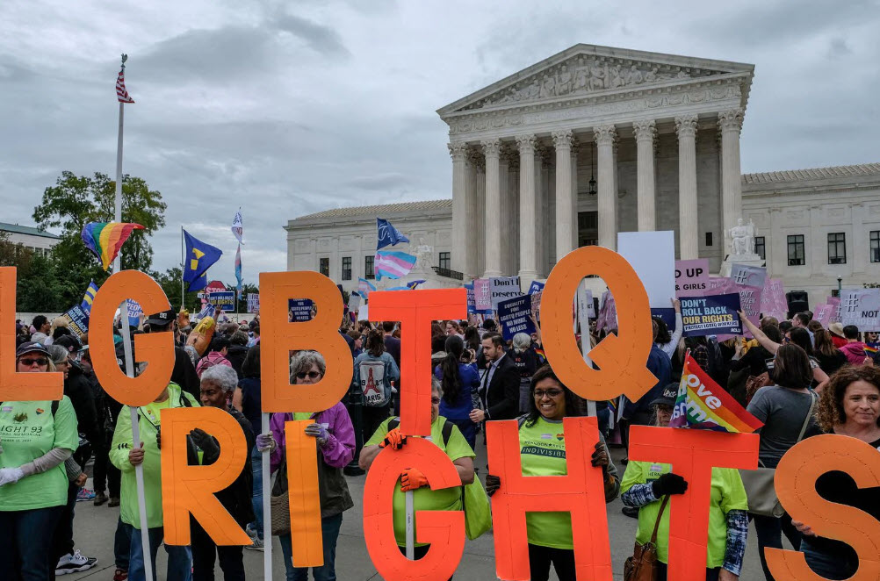
Cases Before the Supreme Court
October 2019

Slide 66
The Supreme Court heard three cases involving employment discrimination of two gay employees and one transgender employee.
At issue: Do the protections offered to employees “on the basis of sex” in Title VII of the 1964 Civil Rights Act also protect employees who identify as lesbian, gay and transgender?

Slide 67
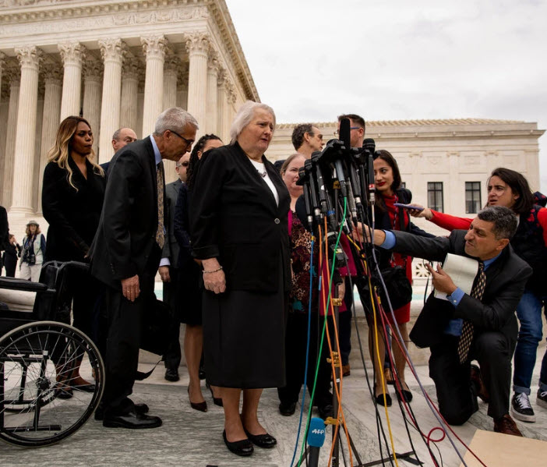
The Plaintiffs
Gerald Bostock – Fired because he joined a gay-friendly community sports team.
Donald Zarda – Fired because he was gay.
Aimee Stephens – Fired because she transitioned from a male to a female.
Aimee Stephens in front of the Supreme Court building.

Slide 68
On June 15, 2020, the Justice’ s ruling on the cases was announced.
SCOTUS ruled with the plaintiffs. Title VII of the 1964 Civil Rights Act protects LBGTQ employees from employment discrimination.
The Justices determined that Title VII’s protection “because of sex” applied to LBGT employees.
“It is impossible to discriminate against a person for being homosexual or transgender without discriminating against that individual based on sex.”
Justice Gorsuch in majority opinion
Source: Liptak, A, (June 15, 2020). Civil Rights Law Protects Gay and Transgender Workers, Supreme Court Rules. New York Times.

Slide 69
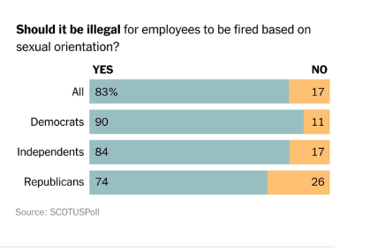
The 2020 SCOTUS ruling is supported by public opinion
Source of Graph: Liptak, A, (June 15, 2020). Civil Rights Law Protects Gay and Transgender Workers, Supreme Court Rules. New York Times.

Slide 70
The lives of LBGTQ employees who work in states that did not specifically offer employment protections on the basis of sexual orientation and gender identity have been positively impacted.
That’s employees in MORE THAN HALF of the states in the US, where state law did not already offer employment protection for employees identifying as LBGTQ.

Slide 71
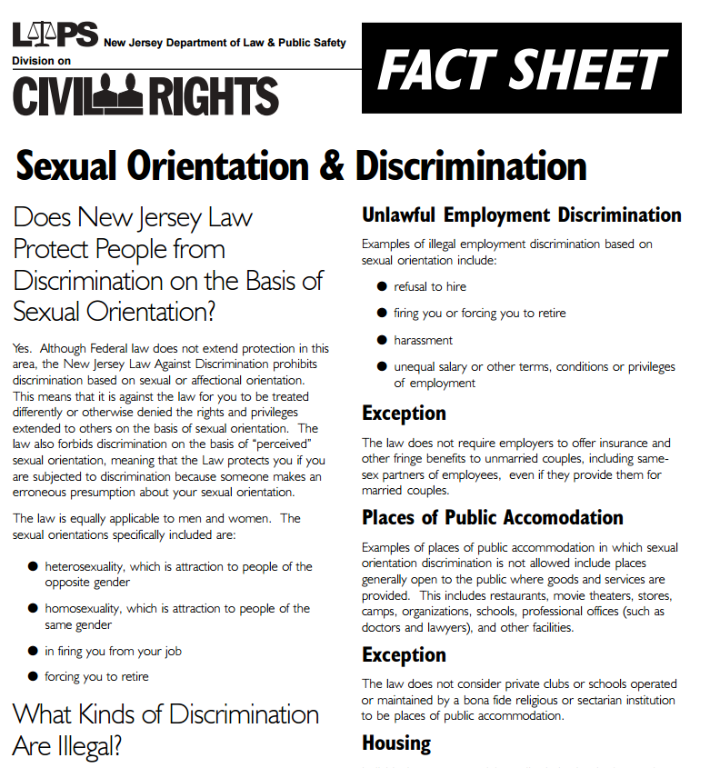
New Jersey Law
Both sexual orientation and gender identity were already protected under New Jersey's LAD (Law Against Discrimination before the 2020 Supreme Court ruling.

Slide 72
Regardless of the ruling, there will be people who do not support employment rights for people who identify as LBGTQ .
“This has to stop. The more and more we give to the homosexual community, the more and more this nation is going to be destroyed,” said Jacob Phelps, 36, from Topeka, Kansas, who held a sign that read, “Jesus will return in wrath.” “It’s very easy in the workplace, shut your mouth, do what you’re supposed to do.”
Source: For LGBT people outside U.S. Supreme Court, Cases Have a Familiar Ring, October 8, 2019, Reuters.
https://www.reuters.com/article/uk-usa-court-lgbt-rally/for-lgbt-people-outside-u-s-supreme-court-cases-have-a-familiar-ring-idUSKBN1WN22N

Slide 73
Contemporary Issues: What’s Going on in the US?
Businesses support the LBGTQ employee continue to increase
Historic representation in the 116th US Congress

Slide 74

Human Rights Campaign Corporate Equity Index (CEI) 2020
Since 2002, each year the nonprofit advocacy group Human Rights Campaign has measured the support that companies offer their LBGT employees.
In 2020, 686 major business earned a top score of 100% on the CEI. Some of year’s statistics on the next several slides.
Source: Corporate Equity Index, 2020. https://assets2.hrc.org/files/assets/resources/CEI-2020.pdf?_ga=2.216162454.1409974327.1592347854-1874565387.1592347854

Slide 75

2020
Source of Chart: Corporate Equity Index, 2020 – page 6. https://assets2.hrc.org/files/assets/resources/CEI-2020.pdf?_ga=2.216162454.1409974327.1592347854-1874565387.1592347854

Slide 76
Transgender Inclusive Benefits
Large corporations are increasingly abandoning health-care benefit discrimination by providing benefits that include medically necessary transition-related care for trans employees. While these types of benefits were only offered by 5% of major US companies in 2002, (when HRC began the Corporate Equity Index) as of 2020, 65% of all major companies offer the benefits to employees. (88% of those participating in the equity index for 2020)
(p. 6 of 2020 Corporate Equity Index.)

Slide 77
Corporate Citizenship for LBGTQ Rights
“Over the last five years, the rates of corporate engagement on matters of LGBTQ equality under the law and LGBTQ-related public policy have skyrocketed. As hundreds anti-LGBTQ bills proliferated across the states over the last several years of legislative sessions, businesses spoke out and rebuked attempts to undermine LGBTQ civil rights at record rates from state-to-state. These corporate leaders are speaking out not just
on principle but also because anti-LGBTQ bills that attempt to curb access to public services for transgender people, or deny basic services to LGBTQ families, or preempt local nondiscrimination ordinances ultimately put their employees and their families, as well as their
customers, at risk. “
Source of Quote: Corporate Equity Index, 2020. page 25 https://assets2.hrc.org/files/assets/resources/CEI-2020.pdf?_ga=2.216162454.1409974327.1592347854-1874565387.1592347854

Slide 78
Historic representation in the 116th US Congress
In 2019, a historic 10 legislators who identify as gay, lesbian or bisexual were sworn into the 116th US Congress.
“The relationships these LGBTQ lawmakers will build with their colleagues on Capitol Hill are transformative, and with an unprecedented number of women and people of color also joining the 116th Congress, equality issues will finally receive the attention they deserve.”
Mayor Annise Parker President and CEO, LGBTQ Victory Institute
Source: Reynolds, D. (January 3, 2019). Meet the 10 Gay, Lesbian, and Bisexual Members of the 116th Congress. Advocate. https://www.advocate.com/politicians/2019/1/03/meet-10-gay-lesbian-and-bisexual-members-116th-congress#media-gallery-media-1

